Slide 1
Artificial Emotional Intelligence in the Future of Computational Advertising
Kaveh Bakhtiyari
University of Duisburg-Essen, Germany The National University of Malaysia (UKM)
www.bakhtiyari.com
22 April 2019 – Iran University of Science & Technology, Tehran

Slide 2
BIO

Slide 3
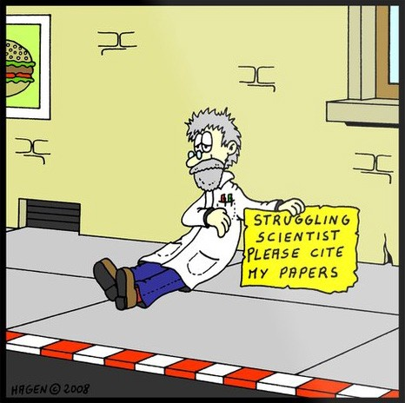
BIO: Academic Publications
h-Index: 9
Citations: ~500
Co-authors: 25
From:
22 Institutes
9 Countries

Slide 4
Outline
Recommender Systems
Computational Advertising
Affective Computing
Problem Statement
Research Questions / Objectives
Methodology
Results
Conclusions & Future Work
References
Q&A

Slide 5
Information Overload
“People read around 10 MB worth of material a day, hear 400 MB a day, and see 1 MB of information every second” - The Economist, November 2006.
In 2015, consumption will raise to 74 GB a day - UCSD Study 2014

Slide 6
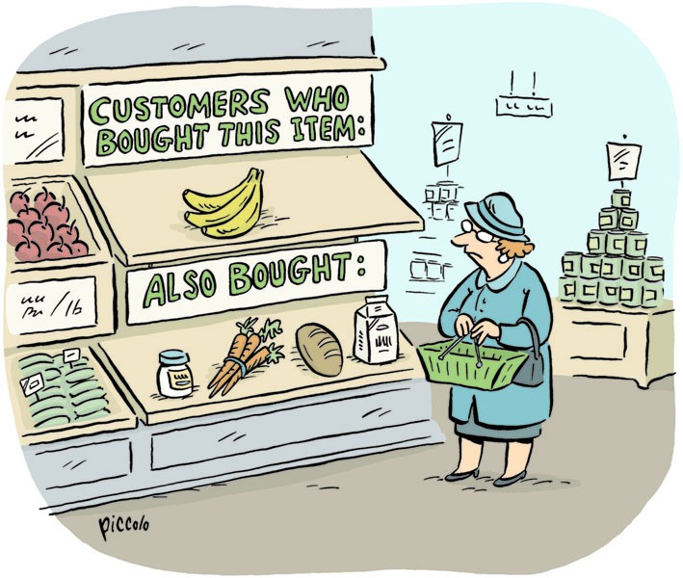
Recommender Systems

Slide 7
Recommender System
What is a Recommender System?
Recommender Systems (RS) generate a list of items (or people) to be recommended to the users. These systems predict the rating of the item which the user would give.
Recommender Systems (RS) was being discussed in Data Mining and Information Filtering (Information Retrieval) areas, but it has been chosen as a separate research area in 1990s and it is becoming very popular.
Estimate a utility function to predict how a user will like an item.

Slide 8
Recommendation
CNN Money, “The race to create a 'smart' Google”:
The Web, they say, is leaving the era of search and entering one of discovery. What's the difference?
Search is what you do when you're looking for something.
Discovery is when something wonderful that you didn't know existed, or didn't know how to ask for, finds you.

Slide 9
Why is Recommender System important?
Netflix: 2/3 of the movies watched are recommended
Google News: recommendations generate 38% more click-through
Amazon: 35% sales from recommendations
Choicestream: 28% of the people would buy more music if they found what they liked.

Slide 10
RS as a Research Area
Recommender Systems (RS) was being discussed in Data Mining and Information Filtering (Information Retrieval) areas, but it has been chosen as a separate research area in 1990s and it is becoming very popular.

Slide 11
Recommender System
Common Recommender Systems Approaches
Content-based Filtering
Item Similarity
Processing the features of the selected item and recommending based on the similarity of the other items.
Recommended items are usually from a same category.
Collaborative Filtering
User Similarity
Recommending items which are selected by the other similar users.
Hybrid
Combination of Content-based and Collaborative filtering.

Slide 12
Recommender System Applications
Computational Advertising
A new research area since 2010.
Online advertising system (e-marketing) is the target platform of this research to present the proper advertisements to the right users.
Users are willing to view the relevant advertisements due to their needs and they might be angry by watching and facing the irrelevant ads (false positive).

Slide 13
Future of Advertising…
Here is the future of personalized content (computational advertising) by Recommender System and Artificial Intelligence……
Notes:
Tom Cruise

Slide 14
Future of Advertising…
Minority Report (2002)
By Steven Spielberg
IMDb: 7.6/10
https://www.imdb.com/title/tt0181689/
Notes:
Tom Cruise

Slide 15
Notes:
Minority Report (2002)
https://www.youtube.com/watch?v=7bXJ_obaiYQ

Slide 16
Current State of Advertising…
Ralph Breaks the Internet (2018)
By Phil Johnston, Rich Moore
IMDb: 7.1/10
https://www.imdb.com/title/tt5848272

Slide 17
Notes:
Ralph Breaks the Internet (2018)
Popup: 00:23:43 - 00:24:25

Slide 18
Do you like Ads?

Slide 19
Notes:
Ralph Breaks the Internet (2018)
Popup-blocker: 00:28:39 - 00:29:26

Slide 20
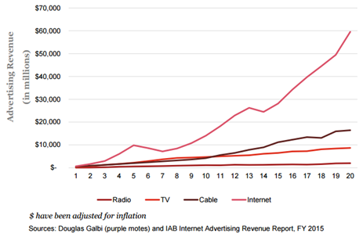
Computational Advertising
In 2015, there were revenues of $59.6 billion from the online advertisements in the United States, which shows a 20.4% growth over the previous year.
In 2016: $72.5 billion; In 2017: $88.0 billion (with 21.4% growth)
In order to increase the revenues, companies tend to deliver more relevant advertisements to the users to attract more attentions and conversions.
In 2008, Broder coined the research area of Computational Advertising in order to deliver more relevant Ads to the users, and gain higher number conversions on online advertisements.

Slide 21
Why Internet Advertising?
Personalization

Slide 22
Ad Effectiveness
Advertisement effectiveness depends on many factors:
logo design, content, color and images affect the brand awareness and branding memory.
Effectiveness Evaluation:
Performance: Click-through rates (CTR) and the conversion rate. CTR counts the number of clicks on an Ad campaign, and conversion is the user’s activity for using, purchasing, or subscribing on the target website after clicking on the Ad. Performance model was applied on 65% of internet Ads in 2015, which was only 46% in 2005.
Cost-Per-Impression (CPM): CPM is the pricing model based on every thousand impressions (views) of an Ad.
Hybrid: it is a combination of both performance and CPM models.
The user satisfaction and user’s experience over the online advertisements are the main evaluation metrics. In this case, intrusiveness, annoy, incentives, salience, and other visual features of the advertisements come into the play.

Slide 23
Advertisement Delivering
There are two aspects on delivering an effective Ad:
Content
It is about what item should be recommended.
Presentation
It is about how the selected item should be presented:
1. Frame size
2. Position
3. Animation

Slide 24
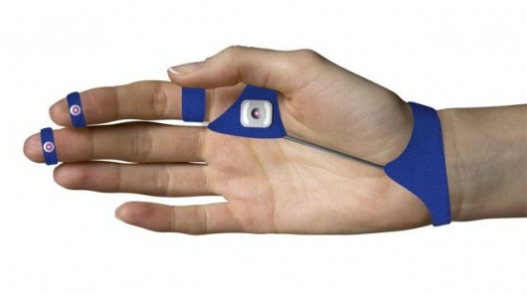
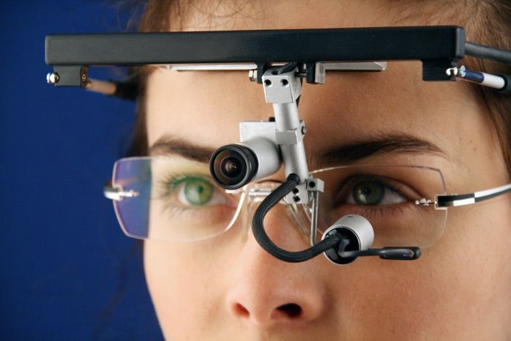
Look, Think, Feel
What is the user looking at?
Eye Tracking:
Image Processing High Computational Cost
Requires Web Cam
Privacy Issues
What is the user thinking about?
EEG Device
How is the user feeling?
Affective Computing:
(Facial Expressions)
(Skin Conductance)
(Heart Rate)
(Wearable devices)
etc.

Slide 25
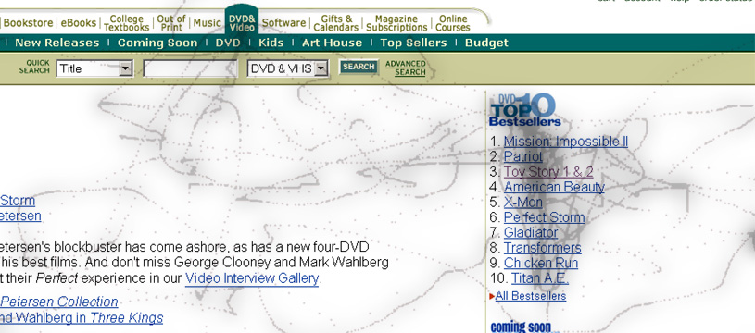
Human – Computer Interaction
Analysis of human-computer interaction features such as mouse movements, keyboard keystroke dynamics, and touch-screen interactions.
Image Source: Cheese Project, MIT University

Slide 26
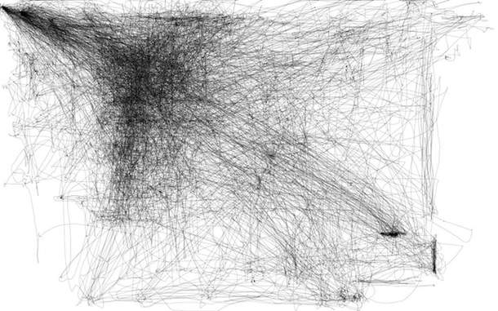
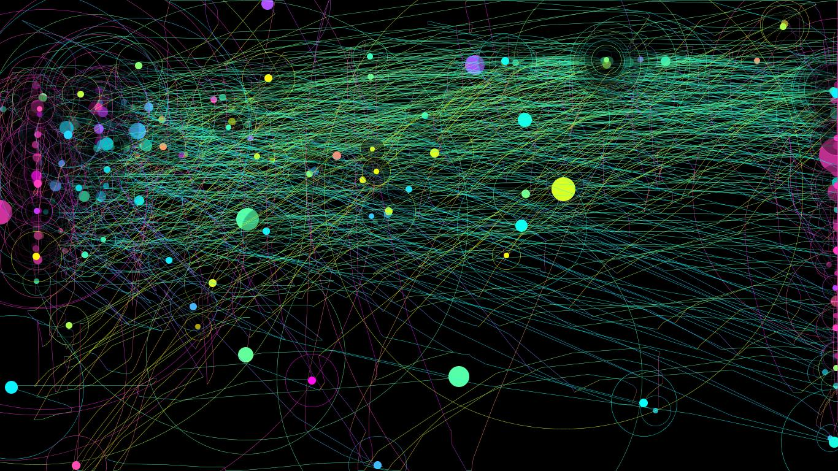
Mouse Interactions
Mouse movements on screen for 2-5 hours

Slide 27
Problem Statement
What is the PROBLEM with the online Advertisements?

Slide 28
Notes:
Ralph Breaks the Internet (2018)
Annoyance: 00:48:46 - 00:50:09

Slide 29
Problem Statement
According to the literature on online advertisements more visually salient (intrusive) banners are more disturbing and annoying.
A website with annoying banners can easily jeopardize the reputation of the service provider and the promoted brand.
Objective:
To deliver the contents with a balance of visual saliency and annoyance in order to gain more profit without losing the reputation and the users.
Notes:
Online advertising is rapidly growing and it is also moving toward being more intrusive to be more effective and to increase the overall click-through and conversions. This phenomenon has made an annoying and irritating experience for the users and even some users felt violated and molested by the presence of high intrusive and salient Ads.

Slide 30
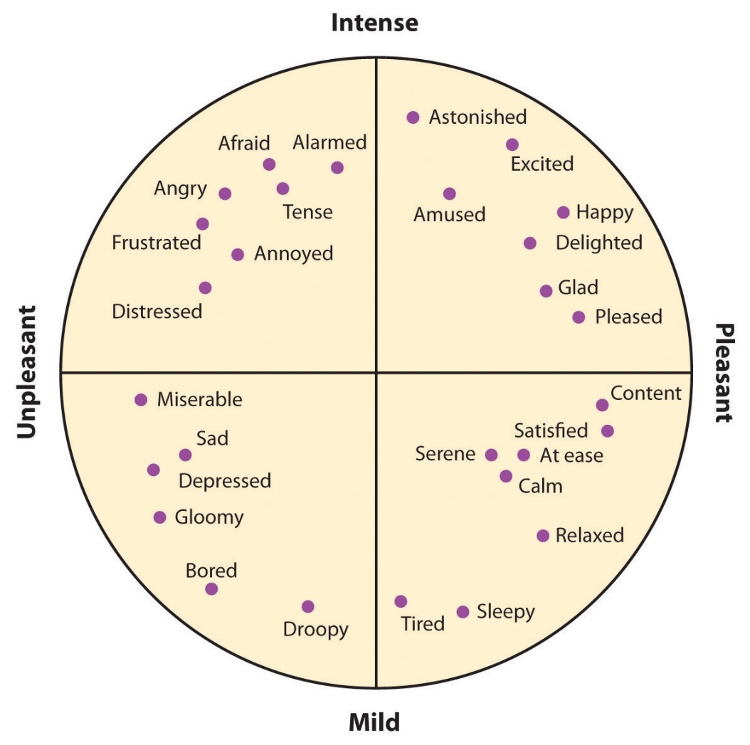
Computational Advertising & Affective Computing
When we are talking about Ad’s effectiveness, user’s emotions and how they feel is important.
Therefore….
We need to study the user’s emotions

Slide 31
Human Emotions
Why Emotions?
You experience emotion, your body reacts, and you behave in response to the emotion.
Emotions are non-verbal messages, and we can understand each other (Essential part of Emotional AI).
Emotions are critical in our survival, thrive, and avoid danger.
Emotions affect the decision making process.
Emotions are motivational to take an action.

Slide 32
Affective Computing
Affective computing is the study and development of systems and devices that can recognize, interpret, process, and simulate human affects (emotions).
It is an interdisciplinary field spanning computer science, psychology, and cognitive science.

Slide 33
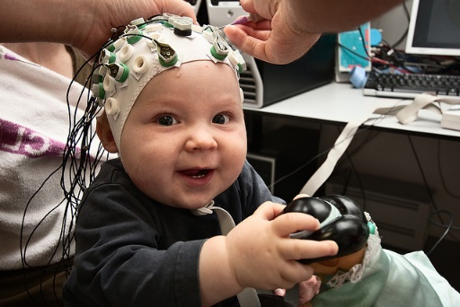
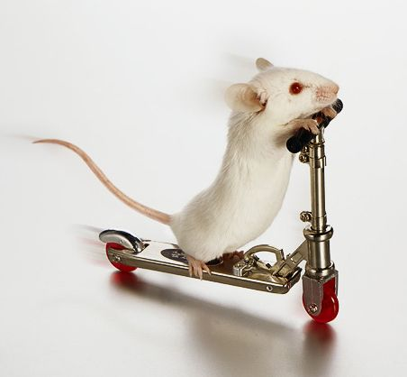
Affective Computing Areas
Facial Expressions
EEG
Skin Conductance
Heart Rate
Respiration
Speech
Text
Human-Computer Interactions (Mouse movements, keyboard keystroke dynamics, etc.)
and many more…

Slide 34
Research Questions
RQ1: How do the different types of Ad’s presentation attract the visual attention?
RQ2: What is the extent of perceived annoyance for different types of Ad’s presentations?
RQ3: Is there any significant difference between male and female users’ perceived attention and annoyance against the Ads?
RQ4: Do the emotions effect the user’s attention and perception on online advertisements?
Notes:
4 Research Questions

Slide 35
Study Framework
Emotion
Valence
Arousal
Advertisements
Positive Negative
High Low
Position
User’s Perception
1: Outline 2: Inline
Animation
Visual Attraction
1: Low 2: High (>1fps)
Annoyance
Frame Size
1: Small 2: Large

Slide 36
Methodology
To address the research question, a survey is designed based on the study framework.
This survey questions the user’s idea about intrusiveness/saliency and annoyance of 12 different forms of advertisement presentations.
These 12 cases were selected based on three features of ad presentation.
Cases were presented in a random order.
This survey also asks the user’s emotion explicitly (self-reported emotion) based on the PAM model.

Slide 37
Survey: Cases
Ad Type | In/Out-line | Position | Animation | Frame Size | Case #
Horizontal
 | Outline | Top – Bottom | Low |  | 1
 | Outline | Top | Low | Big Size | 5
 | Outline | Bottom (fixed) | Low |  | 6
Vertical
 | Outline | Right – Left (fixed) | Low | Skyscraper | 3
 | Outline | Right – Left (Fly-in) | Low/Medium | Skyscraper | 8
 | Outline | Right – Left (Fly-in) | High | Skyscraper | 9
Square
 | Outline | Right – Left (fixed) | Low | Skyscraper | 2
 | Inline | Middle of text | Low |  | 4
 | Inline | Middle of text | High (Video) – Muted |  | 10
 | Inline | Middle of text | High (Video) – Sound |  | 12
Full / Half Screen
 | Outline | Middle/Center | Low | Half Screen | 7
 | Outline | Page Transition | Low/Medium | Full Screen | 11

Slide 38
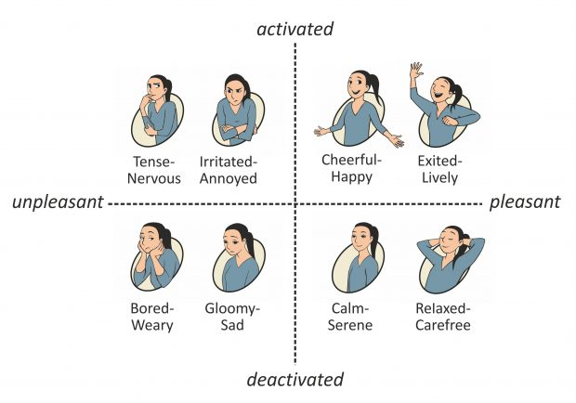
Emotion Selection based on PAM model
Selecting an emotion based on PAM model from a list of 9 Emotions including “Neutral”.
These 9 emotions are clustered in terms of valence and arousal.

Slide 39
Survey Questions
Q1) How much does the presented advertisement attract your attention?
Q2) How much does the presented type of advertisement annoy you?
Q3) How much does the presented type of advertisement distract your concentration (focus) on the main content?
Q4) If this type of advertisement is being shown frequently, how much does it make a negative perception/attitude towards the product/service/brand?

Slide 40
Survey Questions
Q1 and Q3: Visual Intrusiveness
Q2 and Q4: Annoyance
Answers in scale of 1 to 5
1: Very low; 3: Medium; and 5: Very high.

Slide 41
Results: Demographic and Emotions Distribution

Slide 42
Results: Raw Data and Answers Correlation
RQ3:
Even though male participants showed being more attracted to the advertisements, no significant difference between male and female participants was observed.
Correlations of answers to the survey questions
 | Q1 | Q2 | Q3 | Q4
Q1 | 1
Q2 | 0.533025 | 1
Q3 | 0.979866 | 0.53969 | 1
Q4 | 0.652699 | 0.91148 | 0.650396 | 1

Slide 43
Results: Effect of Presentation Features
ANOVA with Eta-squared analysis on the effects of features on VI and AN
* df (Between groups): 1; df (Within groups): 1918; F-crit: 3.8463
 | VI |  |  | AN
 | F | p | Eta-Squared | F | p | Eta-Squared
Position | 24.6102 | < 0.00 | 0.0126 | 73.1269 | < 0.00 | 0.0368
Frame Size | 6.4398 | 0.011 | 0.0033 | 60.2119 | 0.0483 | 0.0057
Animation | 85.5155 | < 0.00 | 0.0428 | 3.9068 | < 0.00 | 0.0302
The means and error bars of the ad's features

Slide 44
Results: Emotional-Aware Intrusiveness and Annoyance
ANOVA with Eta-squared values on the emotions for VI and AN
* df (Between groups): 4; df (Within groups): 1915; F-crit: 2.376574
 | VI |  |  | AN
 | F | p | Eta-Squared | F | p | Eta-Squared
Emotion | 10.30881 | < 0.00 | 0.021 | 11.91755 | < 0.00 | 0.0242
Intrusiveness recommendation based on the emotional dimensions
Dimensions | Intrusive Ads Recommended | Non-Intrusive Ads Recommended
Valence | Positive (+) | Negative (-)
Arousal | Low ↓ | High ↑

Slide 45
Findings…
RQ1: Animation and Position features of an online ad have the most affect in visual intrusiveness/saliency.
RQ2: Position of an ad has more annoying effect and generally more intrusive/salient ads are more annoying.
RQ3: No significant difference between the males and females was observed.
RQ4: Emotions effect the user’s attention and perception on online advertisements, and intrusive ads are recommended to the people with positive valence and lower arousal level.
Notes:
Answers to the research questions

Slide 46
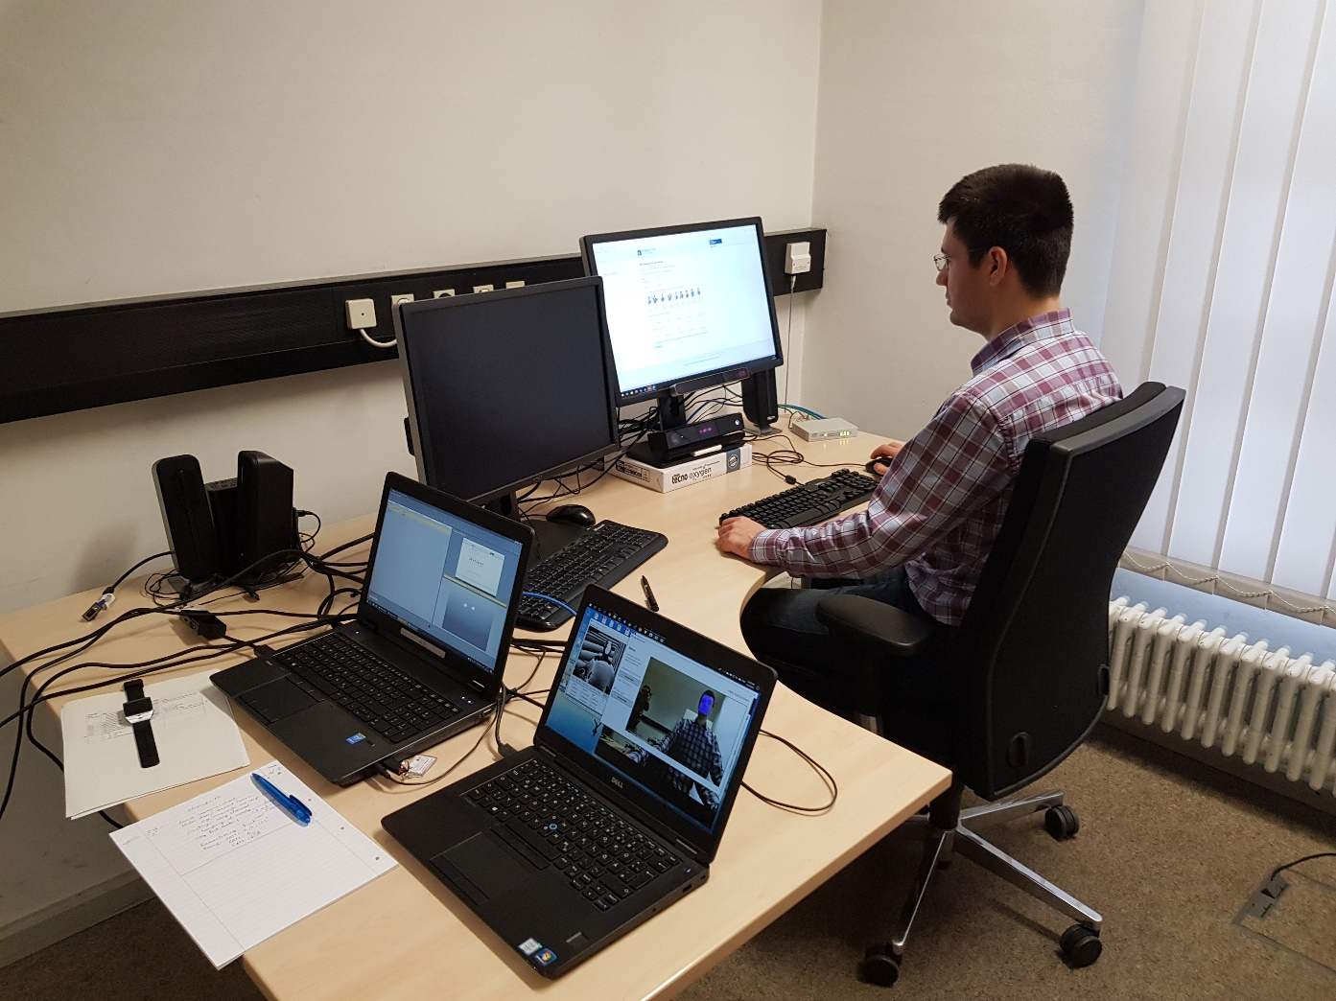
Experiment
Interaction with different contents
Text / Video / Interactive Media
Measuring:
Eye Movements (Eye Tracking System)
Heart Rate Signal
Respiration Signal
Mouse Interaction
Keyboard Keystrokes
Visual Expressions

Slide 47
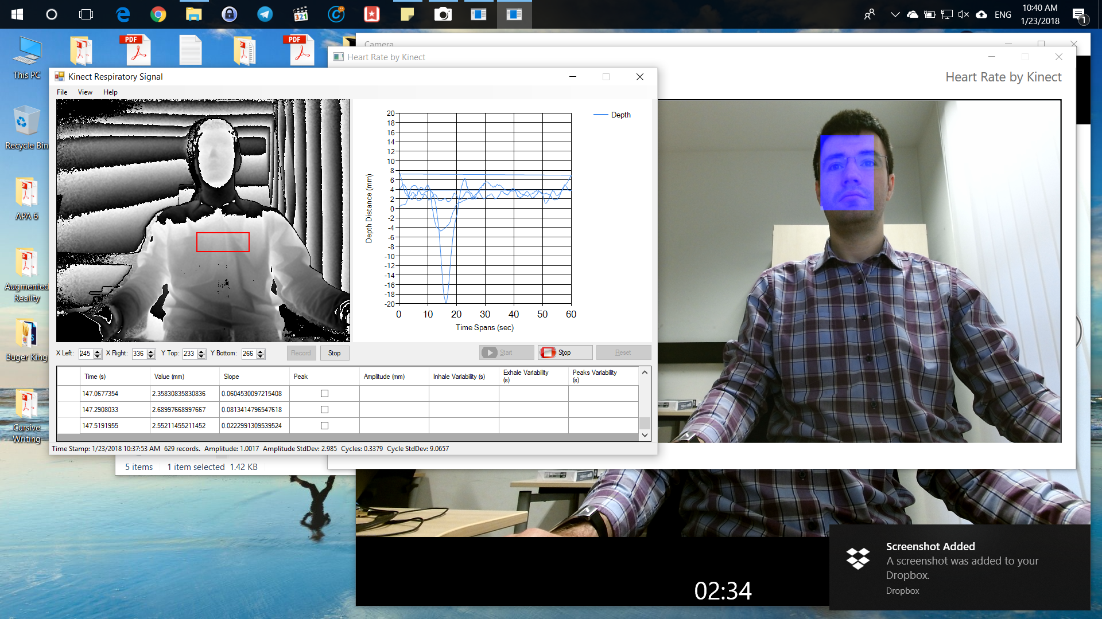
Experiment: Sample Participant

Slide 48
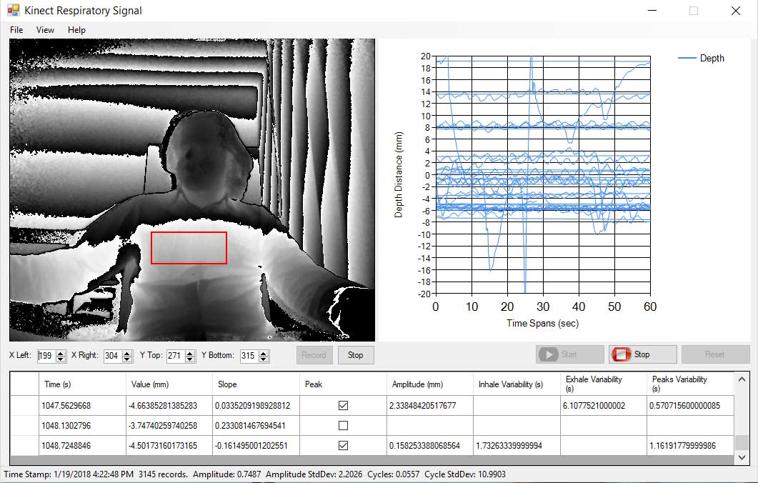
Experiment: Sample Participant
KinRes. Available on GitHub (https://github.com/kavehbc/KinRes)

Slide 49
Eye Tracking Sample

Slide 50
Future Works: Reinforcement Learning
Customization/Personalization:
In order to place an effective advertising system, an intelligent system should be employed which can observe, learn and recommend better advertisements.
Reinforcement Learning is the best solution; such as “Multi-Armed Bandit” or “Q-Learning”

Slide 51
Future Works: Game Theory
The results will be modeled with a game theory game into the computational advertising systems to recommend the online ads in more effective forms of presentation.
Notes:
Ad’s features and user’s affective states are the independent variables of this research, in order to provide a balance between the ad’s intrusiveness and user’s annoyance and tolerance toward an ad.
Game Theory:
Nash Equilibrium
Paereto Optimal

Slide 52
Future Works
Metaphor Semantic
Processing the language without considering the language metaphor would narrow the understanding and would limit the usability of the system in Human Computer Interaction (HCI).
To address the above issue, Metaphor Semantic Ontology can be suggested. Metaphor is a linguistic term which talks about the literature background and human cultural differences. The integration of metaphor into the semantic ontology might result the better effect of machine understanding. Metaphor Semantic Ontology can build multi-cultural systems which are able to communicate and understand the users individually from various cultural backgrounds.

Slide 53
References
1. Agarwal, A., Hosanagar, K., and Smith, M.D., 2011. Location, location, location: An analysis of profitability of position in online advertising markets. Journal of marketing research 48, 6, 1057-1073. http://dx.doi.org/10.1509/jmr.08.0468
2. Bakhtiyari, K. and Husain, H., 2014. Fuzzy model of dominance emotions in affective computing. Journal of Neural Computing and Applications 25, 6, 1467-1477. http://dx.doi.org/10.1007/s00521-014-1637-6
3. Bakhtiyari, K., Taghavi, M., and Husain, H., 2014. Implementation of Emotional-Aware Computer Systems Using Typical Input Devices. In Intelligent Information and Database Systems, N.T. Nguyen, B. Attachoo, B. Trawiński and K. Somboonviwat Eds. Springer International Publishing, Bangkok, Thailand, 364-374. http://dx.doi.org/10.1007/978-3-319-05476-6_37
4. Bakhtiyari, K., Taghavi, M., and Husain, H., 2015. Hybrid affective computing—keyboard, mouse and touch screen: from review to experiment. Journal of Neural Computing and Applications 26, 6, 1277-1296. http://dx.doi.org/10.1007/s00521-014-1790-y
5. Desmet, P., Vastenburg, M., Van Bel, D., and Romero Herrera, N., 2012. Pick-A-Mood; development and application of a pictorial mood-reporting instrument. In Out of Control: Proceedings of the 8th International Conference on Design and Emotion, London, UK, 11-14 September 2012.
6. Hartel, C.E.J., Ashkanasy, N.M., and Zerbe, W.J., 2007. Functionality, Intentionality and Morality. Elsevier.
7. Kuisma, J., Simola, J., Uusitalo, L., and Öörni, A., 2010. The effects of animation and format on the perception and memory of online advertising. Journal of Interactive Marketing 24, 4, 269-282. http://dx.doi.org/10.1016/j.intmar.2010.07.002
8. Lin, Y.-L. and Chen, Y.-W., 2009. Effects of ad types, positions, animation lengths, and exposure times on the click-through rate of animated online advertisings. Computers & Industrial Engineering 57, 2, 580-591. http://dx.doi.org/10.1016/j.cie.2008.08.011
9. Mccoy, S., Everard, A., Polak, P., and Galletta, D.F., 2007. The effects of online advertising. Communications of the ACM 50, 3, 84-88. http://dx.doi.org/10.1145/1226736.1226740
10. Mccoy, S., Everard, A., Polak, P., and Galletta, D.F., 2008. An experimental study of antecedents and consequences of online ad intrusiveness. Intl. Journal of Human–Computer Interaction 24, 7, 672-699. http://dx.doi.org/10.1080/10447310802335664
11. Petrovici, I., 2014. Aspects of Symbolic Communications in Online Advertising. Procedia-Social and Behavioral Sciences 149, 719-723. http://dx.doi.org/10.1016/j.sbspro.2014.08.276

Slide 54
Q&A

